Slide 1
UI Frameworks, Boilerlates & Bootstraps

Slide 2
UI Frameworks, Boilerplates & Bootstraps
What and how useful they are?
Explanation Video (3min):
https://www.youtube.com/watch?v=zJ78W_kdmCA
Bootstrap: https://www.youtube.com/watch?v=V7x_hosDoIo
Top 10 UI Frameworks
https://www.keycdn.com/blog/front-end-frameworks/

Slide 3
What is Boilerplate?
In computer programming, boilerplate is the sections of code that have to be included in many places with little or no alteration. Such boilerplate is particularly salient when the programmer must include a lot of code for minimal functionality.
Why Boilerplate?
Boilerplate is a front-end kickstart template that contains a series of best practices and common inclusions. It offers a generic files/folders structure, HTML5-ready template and basic server-side global configurations.
It’s like blueprint for your house, but without the building blocks. You have the idea what you’re going to build and you have made all preparation steps, but you don’t have the materials needed to actually build the house. You are free to include “the missing” HTML/CSS/JavaScript components from anywhere else, including from Bootstrap.
Notes:
http://www.sitepoint.com/boilerplate-bootstrap/

Slide 4
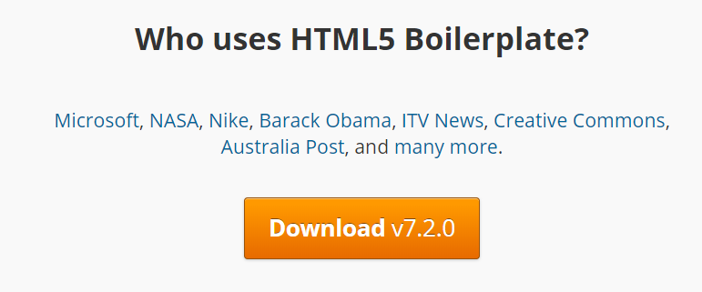
HTML5 Boilerplate Resource
https://www.youtube.com/watch?v=dJ8v1XZS7uc
This video briefly explains the various components of the html5 boilerplate template and how it can be used to create a website project.

Slide 5
Why Boilerplate? Benefits:
HTML5-ready template plus basic structure for your files and folders
Ready-to-use, performance optimized print styles
Cross-browser compatibility
Mobile browser optimizations
Progressive enhancement and graceful degradation
Best-practice server configurations
Optimal caching and compression rules
Optimized Google Analytics snippet code
and more…

Slide 6
Examples of boilerplate benefits:
css – a directory containing normalize.css, and main.css with Boilerplate’s defaults, common helpers, media queries, and print styles.
doc – a directory containing all Boilerplate’s documentation. You can use it as the location for your own project’s documentation.
img – an empty folder for your images
js – a directory containing main.js for your custom code and plugins.js containing the code for all your plugins. Also there are Modernizr and jQuery libraries placed in vendor subfolder.
.htaccess – default web server configurations for Apache. For other servers there is Server Configs repository.
404.html – a very basic error page
crossdomain.xml – a template for working with cross-domain requests.
favicon.ico
humans.txt – a file to include credits for you and your project.
index.html – default HTML5-ready template, the base of all pages on your web site.
robots.txt – a file to include any pages you want to be hidden from search engines.

Slide 7
What is a bootstrap?
Bootstrap is a front-end framework and web design kit for building modern web sites. With Bootstrap you can build an entire web site from scratch. So it gives you not only a starting point, but also all the building blocks you may need to create your site.
The Bootstrap’s download contains only files for CSS and JS components, plus an icon font.
Bootstrap Demo (1:20)
https://www.youtube.com/watch?v=wesUO81YX0U

Slide 8
Why Bootstrap? Benefits:
Mobile-first approach
Browser compatibility
Accessibility
CSS grid system
Ready-to-use components and utilities
Components and utilities are listed below:
Grid – a utility for laying out your design
Icons – resolution independent icon set
CSS base styling classes
CSS components – styled HTML components
JS widgets – a nice set of interactive components
Starting templates and examples

Slide 9
Using Boilerplate plus Bootstrap
Boilerplate is more server-side oriented – a good starting template if you work with server-side technologies such as PHP.
Bootstrap is a client-side solution – a complete toolkit for building client-side web sites.
Boilerplate is only a starting code base and you can add whatever components you need later on.
Bootstrap on the contrary has a full set of ready-to-use components that you can use right now.
You can combine Boilerplate with Bootstrap to get the best benefits of both.
Boilerplate is like the skeleton and
Bootstrap is the flesh for the website

Slide 10
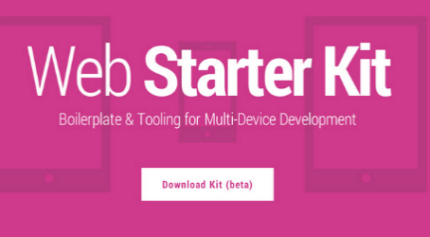


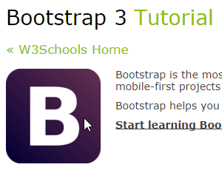
Boilerplate/Bootstrap resources
Google Webkit boilerplate:
http://www.sitepoint.com/google-launches-web-starter-kit/
Skeleton
http://www.getskeleton.com/
HTML5 Boilerplate
html5boilerplate.com
Learn Bootstrap @ w3schools
http://www.w3schools.com/bootstrap/default.asp

